Slide 1
Question 12 (Case 6)
Q9. You are an honest and responsible civil servant. You often observe the following:
(a) There is a general perception that adhering to ethical conduct one may face difficulties to oneself and cause problems for the family, whereas unfair practices may help to reach the career goals.
(b) When the number of people adopting unfair means is large, a small minority having a penchant towards ethical means makes no difference.
(c) Sticking to ethical means is detrimental to the larger developmental goals.
(d) While one may not involve oneself in large unethical practices, but giving and accepting small gifts makes the system more efficient.
Examine the above statements with their merits and demerits. (250 Words, 20)

Slide 2
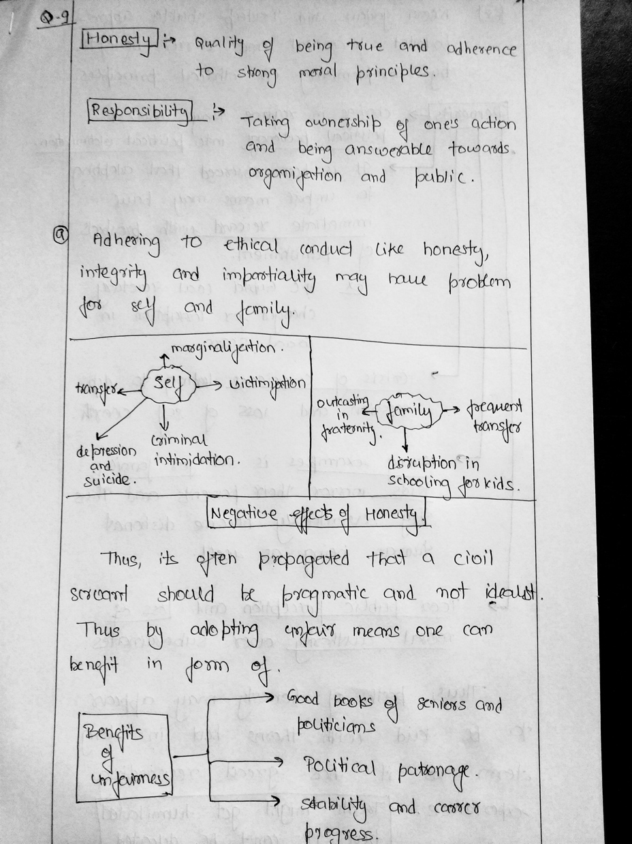

Slide 3
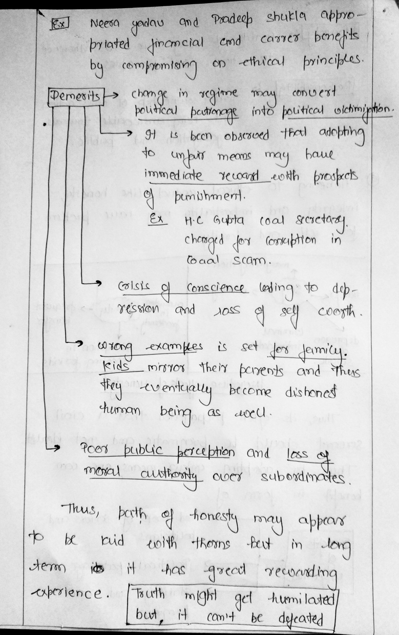

Slide 4
(b) When the number of people adopting unfair means is large, a small minority having a penchant towards ethical means makes no difference.
Viability and effectiveness of minority people who adhere to Ethical Principles when majority is corrupt is often questioned.
Can single Individual make difference under circumstances of Systemic corruption?
Thus, arena of fight against corruption is marred with pessimism and often used as a valid argument for individual to be part of the system and adopt its vices.
However, history have innumerable examples, where a single individual has turned the course of history and had change entire system instead of adopting its vices.

Slide 5
Examples:
Gandhi ji, Martin Luther King, B.R Ambedkar, Abraham Lincoln fought lone battle for social reform against all odds.
Julio Ribero, T.N Seshan, Prakash Singh, Satyendra Dubey, Manjunathan are few Public Servants who despite being alone, fought there battle against the ills of the system and brought about reform in the system itself.
Police reform, RTI, Whistle blower act are few examples of positive outcome of the efforts of small minority who braved all odds.
‘

Slide 6
(c) Sticking to ethical means is detrimental to the larger developmental goals.
Ethical means like.
SIA, EIA, Gram Sabha consent, democratic means, transparency and objectivity in system etc. may slow down the process of development.
Laws like Labour regulation, CSR etc. reduces Ease of Doing Business
On the other side mechanism like Bribing, Lobbying, overlooking of Due process of development may speed up the process of development.
Bribe act as grease to the wheel of administration and thus make it more efficient.
Thus, end justify the means should be ethical guidance system in Process of Development

Slide 7
However, Unethical means adopted to achieve development , may frustrate the process in long term.
Ex.
Bribing may get institutionalized, leading to rent seeking behaviour.
HDI and CPI (corruption Perception Index) are closely related.
Overlooking SIA, EIA may have long term negative impact like . Natural Disaster, climate change etc. thus reversing the process of development.
Because of these factors, Gandhi ji advocated for Right means for the right end.
Thus, for sustainable development, ethical means should be adopted to achieve it.

Slide 8
(d) While one may not involve oneself in large unethical practices, but giving and accepting small gifts makes the system more efficient.
Nazrana/ suvidha shulka etc. are various terminology which aim to legitimize petty forms of corruption.
It is often argued, accepting small gifts in return of service is acceptable and part and parcel of Public services.
Small gifts as goodwill gesture act as motivation for civil servant, and thus makes system more efficient by lubricating wheel of administrative machinery.

Slide 9
However, corruption is corruption and it has same negative repercussion on administration, irrespective of whether bribe is big or small.
Negative impact of accepting small gifts.
Rent seeking behaviour.
Dilute principles of universality, objectivity and Integrity which are foundational values of Civil services.
CoC lays upon strict guidelines against accepting any form of gift in return of services.
Spirit of service, compassion and Patriotism which makes Public services efficient and not these petty gifts.

